Slide 1

PERSON-CENTERED SERVICE PLAN (PCSP)
WITHIN THE ROLE OF THE PASSE CARE COORDINATOR
June 20, 2018

Slide 2
Training Objectives
Person-centered service plan (PCSP)
PCSP minimum requirements- planning, development, and review
Definitions of Care Coordination and Case Management
Conflict Free Case Management—who can provide care coordination and case management services
Care Coordinator roles
Case manager roles
Abeyance - 1915(b) waiver
PASSE Phase I

Slide 3
Person-Centered Service Plan (PCSP)
PASSE is a Provider-led Arkansas Shared Service Entity (PASSE).
It is also an organized care model that is person-centered.
The key role of the Care Coordinator is to ensure the Person-Centered Service Plan (PCSP) is implemented.

Slide 4
Person-Centered Service Plan (PCSP)
Person-centered service planning (PCSP) is an ongoing process to help individuals who receive developmental disabilities (DD) and behavioral health (BH) services plan for their future. In person centered planning, groups of people focus on the individual and that individual’s vision of what they would like to do over the course of the plan year.
The development of the plan should be structured around the information from the functional assessment but care coordinators should also work with service providers to obtain their evaluations and plans of care.

Slide 5
Purpose of the PCSP
To look at the individual being supported in a different way
Assist the individual being supported in gaining or maintaining control over their own life
Increase opportunities for participation in the community
Recognize strengths, preferences, interest, goals and outcomes
Work together developing a plan to make it happen
42 CFR 441.540 Outlines the Person Centered Service Planning Process and requirements of the person centered service plan

Slide 6
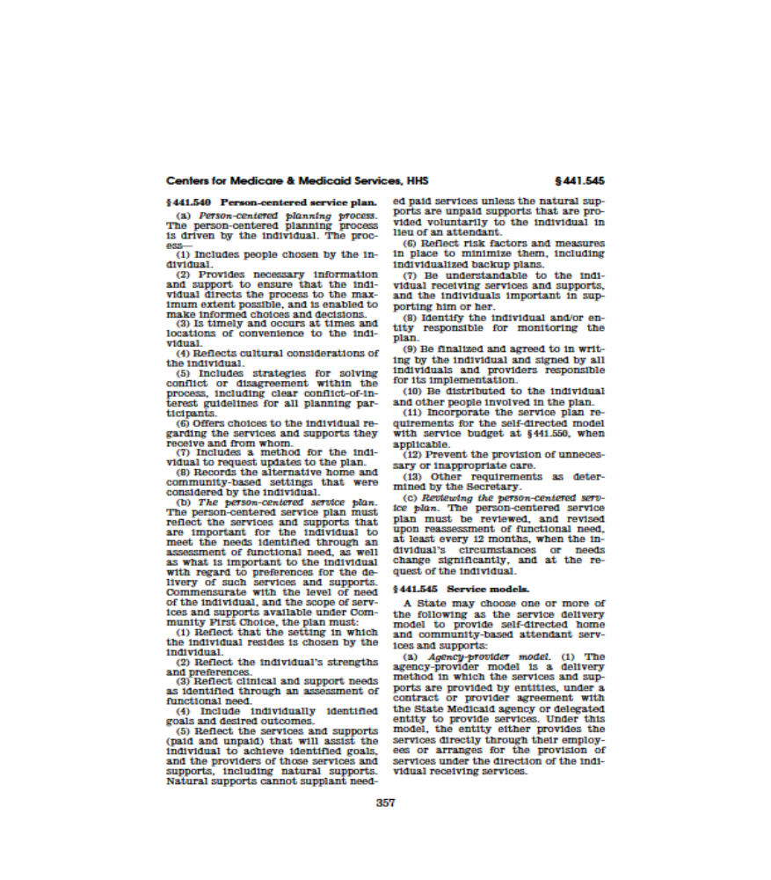
Code of Federal Regulations
Title 42 – Public Health
Volume: 4
Date: 2012-10-01
Title: Section 441.540 Person-centered service plan

Slide 7
Definitions of Care Coordination and Case Management
There is no federal definition of care coordination. Care coordination is defined in Act 775:
  “…means the coordination of healthcare services delivered by healthcare provider teams to empower patients in their health care and to improve the efficiency and effectiveness of the health care sector.
  “…includes without limitation: health education and coaching; promotion of links with medical home services and the healthcare system in general; coordination with other healthcare providers for diagnostics, ambulatory care, and hospital services; assistance with social determinants of health, such as access to healthy food and exercise; and promotion of activities focused on the health of the patient and the community, including without limitation outreach, quality improvement, and patient panel management; and community-based management of medication therapy.”
Case management is defined by federal statute (Sections 1905(a)(19) & 1915(g)(2) and regulation (42 CFR 440.169)

Slide 8
Case management services
“… means services furnished to assist individuals, … in gaining access to needed medical, social, educational, and other services in accordance with section 441.18 of this chapter.”

Slide 9
Who May Provide Care Coordination or Case Management Services
Care coordination and case management are services.
Both must be provided on a “conflict free” basis.
Care coordinators must be employed by the PASSE. Each PASSE must meet network adequacy standards for care coordinators.
Case managers may be PASSE employees or contracted providers or may be subcontractors to a vendor.
If case managers are not PASSE employees, compensation for case management is negotiated between a PASSE and the entities providing the services. Each PASSE must submit its case management strategy and standards for DHS approval.

Slide 10
The Four (4) Elements of Conflict Free
Case Management are:
Assessment of an eligible individual (42 CFR 440.169 (d)(1)
Development of a specific care plan (42 CFR 440.169 (d)(2)
Referral to services (42 CFR 440.169 (d)(3)
Monitoring activities (42 CFR 440.169(d)(4)

Slide 11
What Care Coordination and Case Management are NOT
42 CFR 441.18(a)(2) specifies that the state may “not use case management … to restrict an individual’s access to other services under the plan.”
Therefore:
  They do not provide prior authorization (PA) of services
  They do not perform utilization management (UM)
Both PA and UM are important components of a PASSE, but these functions cannot be assigned to care coordinators or case managers.

Slide 12
What is Expected from the Care Coordination
Initiate contact within 15 days of attribution to a PASSE
Work with individuals when developing a support team that consist of the individual/guardian, provider, and other people that the individual designates as being a part of their support system.
Work with the family when the individual is their own guardian and resides in the home of the parent or other relative.
Monthly face-to-face contacts with beneficiaries within their assigned caseload
Assisting the beneficiary with selecting a PCP or provide a referral to a PCP
Follow up with beneficiaries who have visited an Emergency Room, or an urgent care clinic or been discharged from an inpatient psychiatric unit within seven (7) business days of discharge

Slide 13
What Is Not Expected From the Care Coordinator
Performing Supportive Living services listed in current CES 1915 (c) Waiver
  Residential Habilitation
  Companion and Activities Therapy
  Direct Care Supervision
  Health Maintenance Activities
Aggressive communication which is perceived as threatening the individual and/or family to accept Care Coordination services.
The Care Coordinator DOES NOT take the place of the primary caregiver, but should support them.

Slide 14
PCSP Planning Process Minimum Requirements:
Process must include:
People who attend should be chosen by the individual or guardian
Provides necessary information and support to enable the individual to direct the process to maximum extent possible
Meetings/Contacts are timely and occurs at time and location convenient to the individual
Reflects cultural consideration of the individual
Strategies for resolving conflict within the process including clear conflict of interest
Offers choice to individual regarding services and supports they receive and from whom
Allows method for individual to request updates to plan
Records the alternative home and community-based settings that were considered by the individual or guardian

Slide 15
PCSP Development Minimum Requirements
PCSP must include:
The services and supports important to the individual to meet needs identified in assessment of functional needs
Identifies what is important to the individual
Reflects setting in which individual resides selected by the individual/guardian
Reflects individuals strengths and preferences
Reflects clinical and support needs
Includes individually identified goals and desired outcomes

Slide 16
PCSP Development Minimum Requirements continued
PCSP must include:
Reflects services and supports (paid and unpaid) that will assist individual to achieve identified goals, providers of those services inclusive of natural supports
Risk factors and measures to address inclusive of back-up plans
Be understandable to the individual receiving services and supports and individuals that support him or her
Identify individual/entity responsible for monitoring the plan
Be agreed to in writing by individual/guardian and signed by all individuals/providers responsible for implementation
Distributed to the individual and others involved in the plan

Slide 17
Review Requirements
At least every 12 months
When the individuals circumstances change significantly
At the request of the individual and/or guardian

Slide 18
Abeyance
A temporary suspension of PASSE services, due to:
A temporary loss of Medicaid eligibility
Placement in a setting excluded from the PASSE
Loss of contact with the beneficiary or guardian for more than forty-five (45) days.

Slide 19
PASSE Phase I- now through December 31st
Clients with developmental disabilities or intellectual disabilities receiving services within the Community and Employment Supports (CES) Waiver must comply with the current waiver assurances and promulgated forms
Once a CES waiver client is attributed to a PASSE, the PASSE care coordinator takes over ALL care coordination services and the CES waiver provider can no longer bill for any service except the PCSP development fee of $90.00
The PASSE care coordinator must work with the CES waiver provider to develop any needed PCSPs between now and January 1, 2019

Slide 20
PASSE Phase I- now through December 31st
“ALL care coordination services” includes total coordination of care for the client which includes these key elements that have been performed by the CES Waiver provider up until now:
  ICF eligibility re-evaluations (some clients every 3 years others every 5 years)
  Implementation of the client’s PCSP
  Coordinating between multiple providers
  Attending the PCSP development meeting

Slide 21
Walk On Items

Slide 22
Questions?

