Slide 1

Waiver appeals

Slide 2


Slide 3
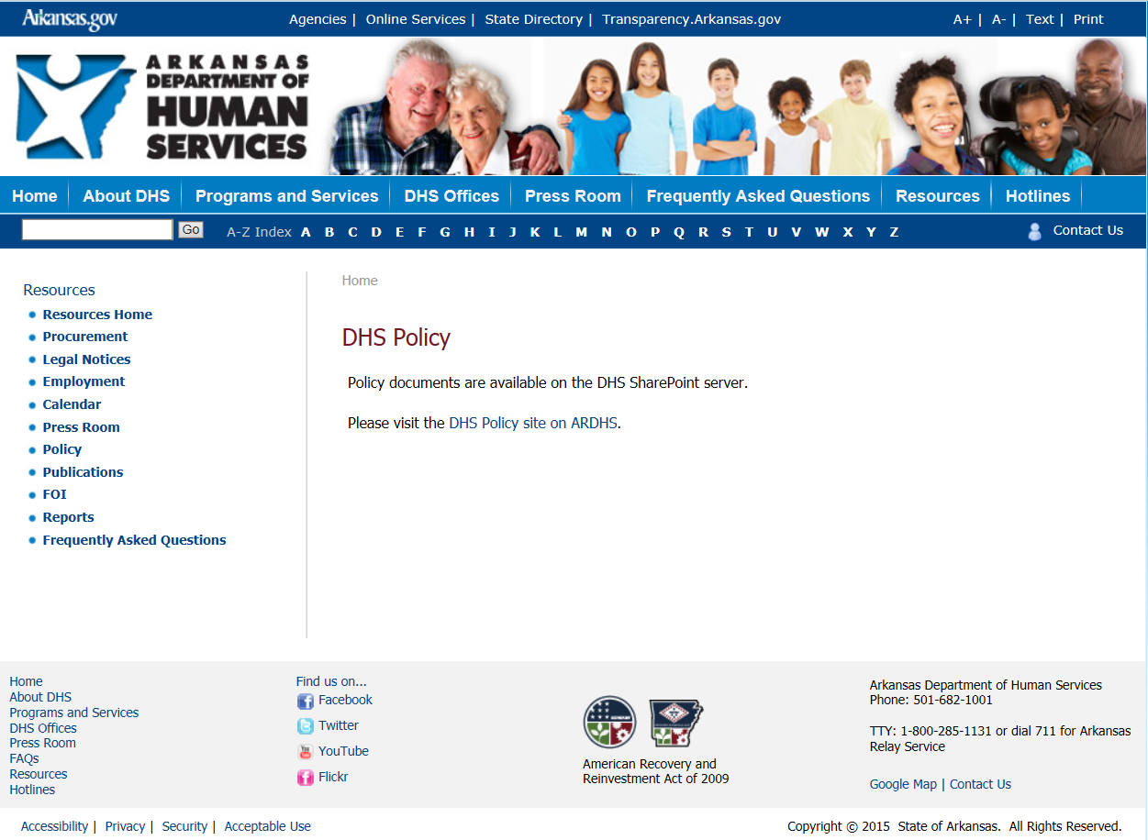

Slide 4
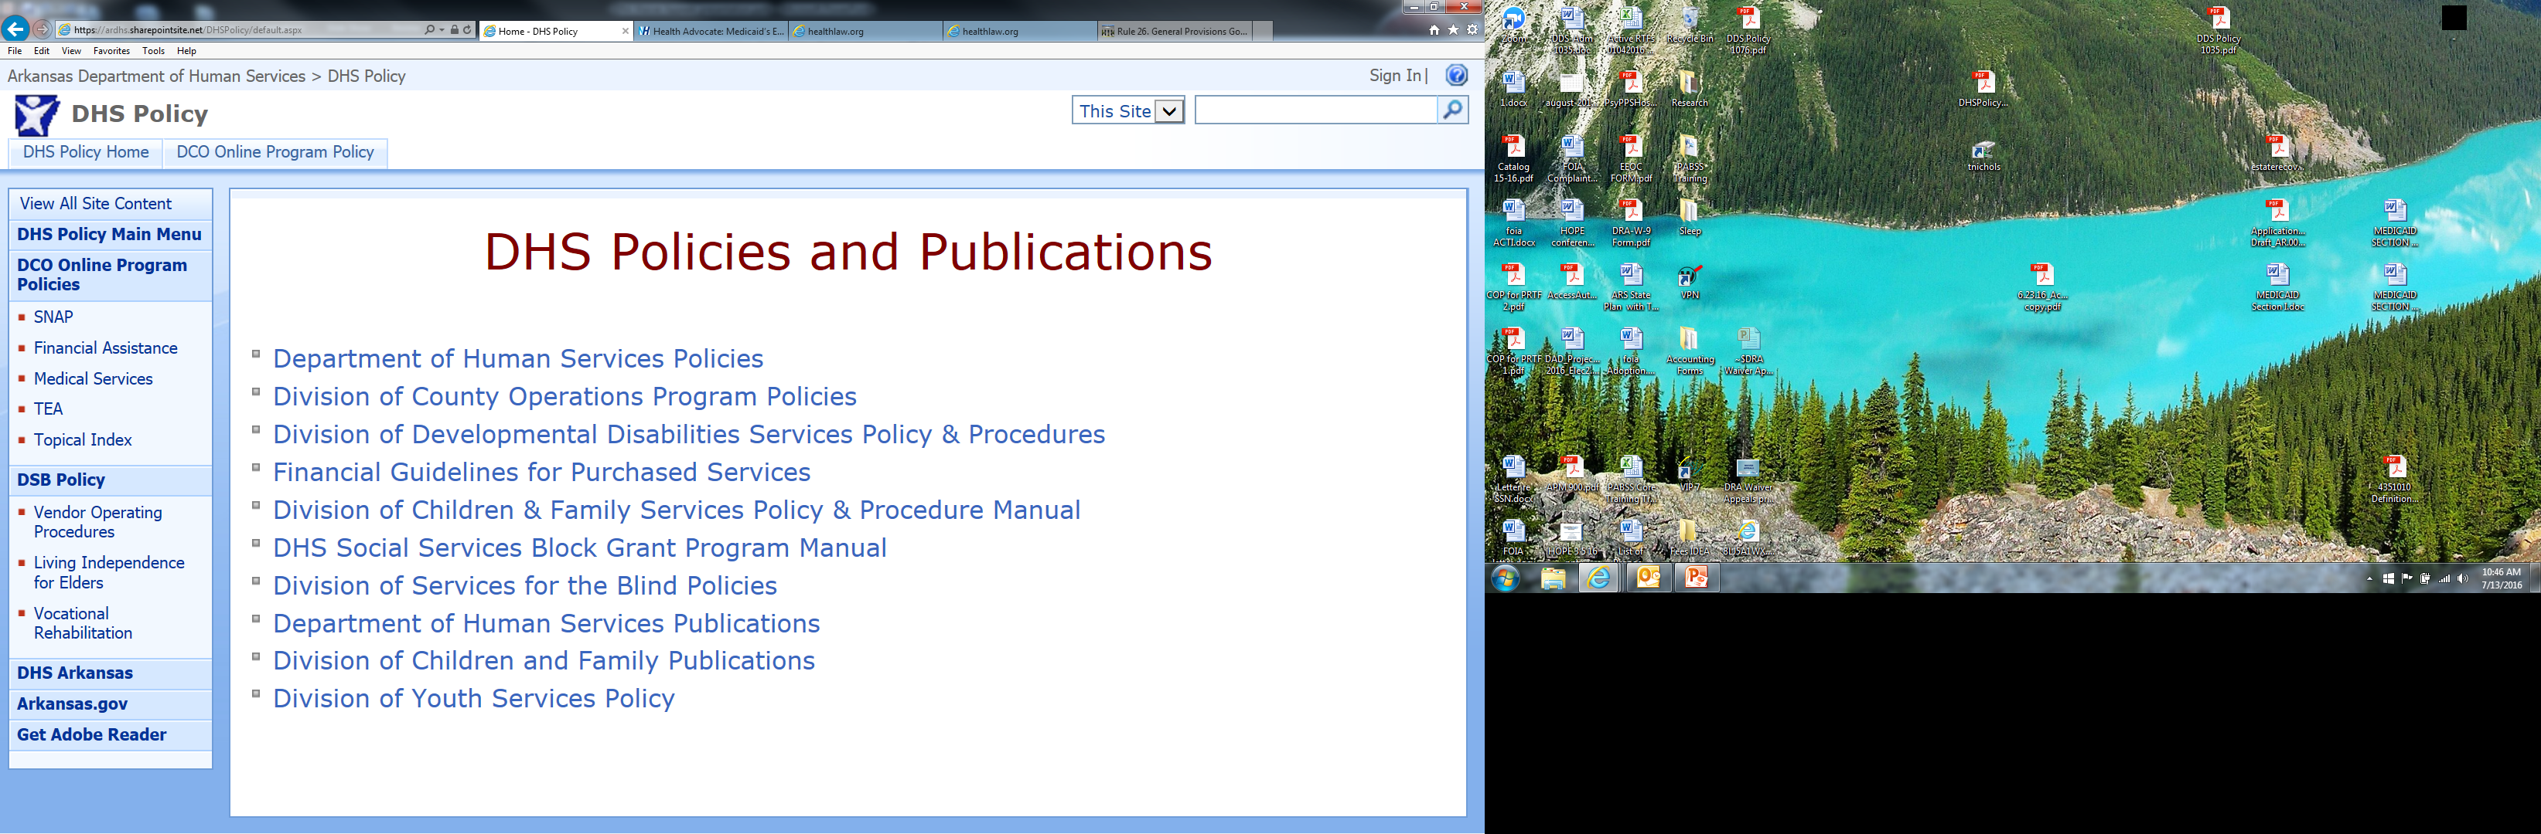

Slide 5
Request for
fair hearing
Anything new?
Anything important you think they overlooked?
Get your witnesses and exhibits ready.
Request evidence from DHS.

Slide 6
Request for
fair hearing
Phone hearing or in-person (by request).
Have your client present.
Not a trial, but it affects legal rights and can be conducted with formality.
Know how much time you have.
  Run through questions to get a sense of time for each witness.
  Make time to prepare your witnesses and yourself.
Consult with an attorney before the hearing if you think there are issues for appeal if you are denied.

Slide 7
procedure
To whom does it need to be sent?
ALWAYS LOOK AT THE LETTER
  Almost always the letter will tell the precise address for you to send the appeal.
  Policy 1098 can be confusing.
  Rely on the letter, keep the letter.

Slide 8
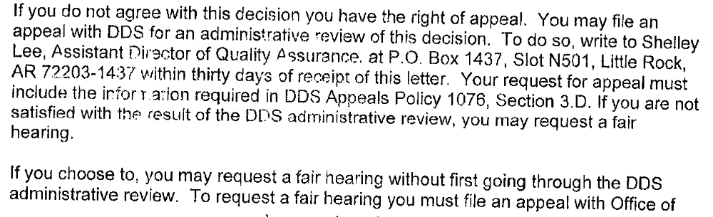
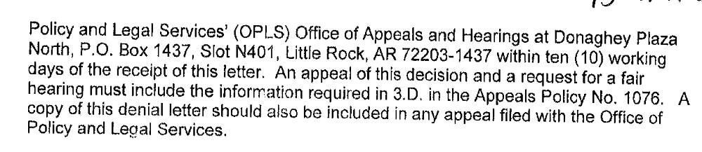

Slide 9
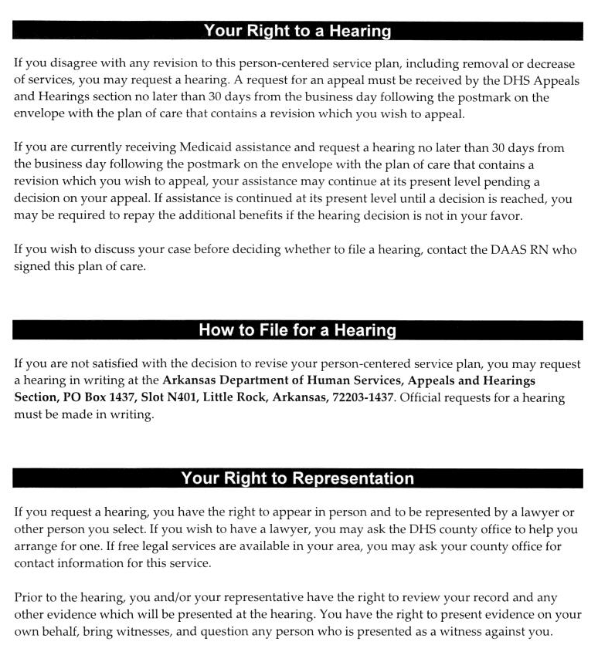

Slide 10
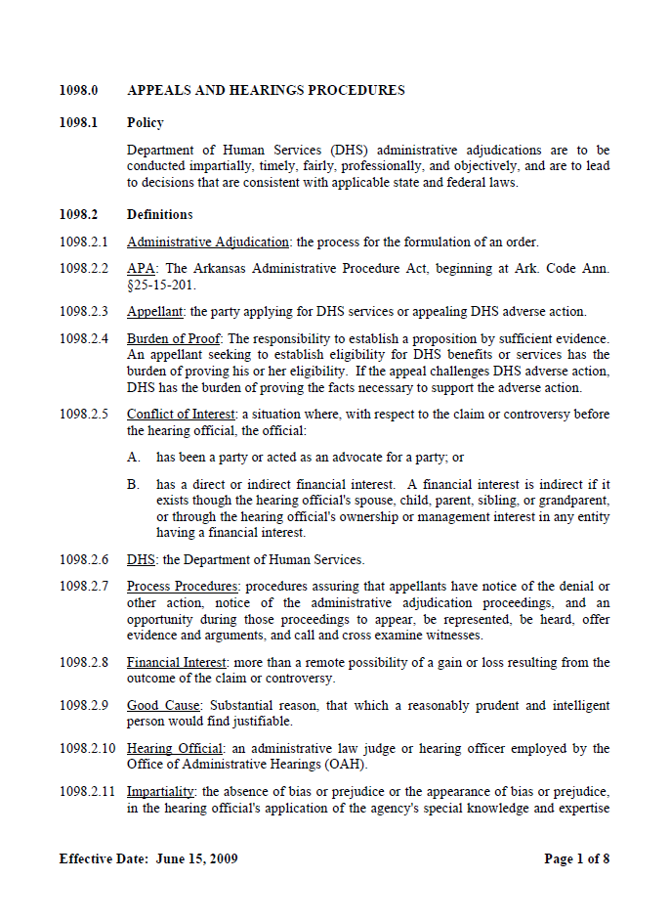
dhs 1098

Slide 11
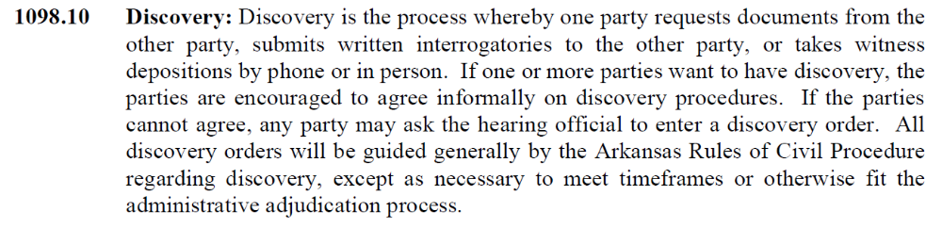

Slide 12
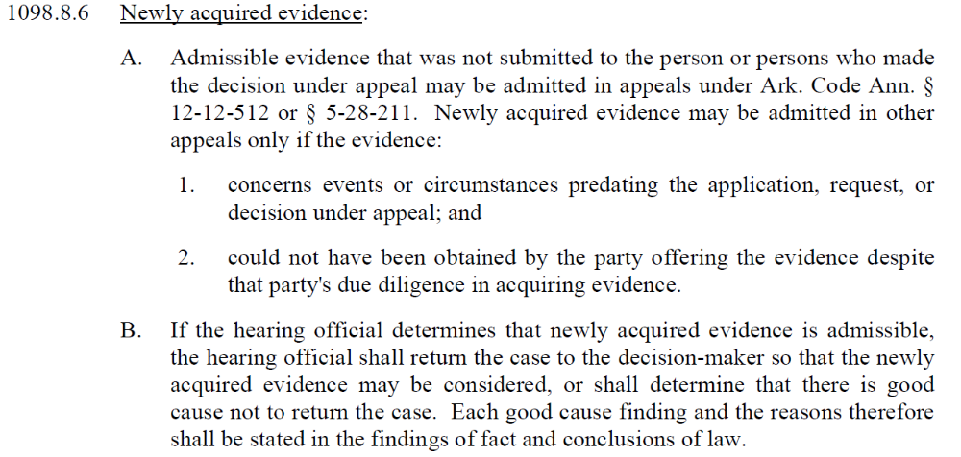

Slide 13
Records
I want all records
  Do not depend on them to send all of the records without your request
Meetings of Psychology Team, Memos, Notes, Correspondence
Communications
Make your requests independently verifiable

Slide 14
Witnesses
Who are they going to call as a witness?
  Are they an “expert?”
  Do you have someone to testify as an “expert?”
Ask your client whether they have ever met or spoken with the witnesses.

Slide 15
Issues

Slide 16
EPSDT
All mandatory and optional services that the state can cover under Medicaid, whether or not such services are covered for adults. 42 U.S.C. § 1396d(a)
“Necessary health care, diagnostic services, treatment, and other measures… to correct or ameliorate defects and physical and mental illnesses and conditions….” 42 U.S.C. § 1396d(r)(5)

Slide 17
Americans with Disabilities Act
“No qualified individual with a disability shall, by reason of such disability, be excluded from participation in or be denied the benefits of the services, programs, or activities of a public entity, or be subjected to discrimination by any such entity.”
42 U.S.C. § 12137
Receipt of services in the “most integrated setting appropriate to their needs.”
28 C.F.R. § 35.130(d), See Olmstead v. L.C. v. Zimring, 527 U.S. 581 (1999).

Slide 18
After the Decision
25-15-212 – Judicial Review
Cannot represent the beneficiary any longer.
“Proceedings for review shall be instituted by filing a petition within thirty (30) days after service upon petitioner of the agency’s final decision [. . .]”
Agency will transmit the record to the court.
The court, not a jury, will review the record.

Slide 19
After the Decision
25-15-212 – Judicial Review
(1) In violation of constitutional or statutory provisions;
(2) In excess of the agency's statutory authority;
(3) Made upon unlawful procedure;
(4) Affected by other error or law;
(5) Not supported by substantial evidence of record; or
(6) Arbitrary, capricious, or characterized by abuse of discretion.

Slide 20
After the Decision
25-15-212 – Judicial Review
[The] failure to assert equal protection claim in administrative proceeding [. . .] barred it from raising equal protection claim in its subsequent federal action against DHS, even if administrative hearing officer led it to believe that it could defer equal protection claim for federal court to decide.
Sparkman Learning Center v. Arkansas Dept. of Human Services, 2014, 775 F.3d 993.
(1) Violation of constitutional or statutory provision

Slide 21
After the Decision
25-15-212 – Judicial Review
It is essential to judicial review under the Administrative Procedure Act that issues must be raised before the administrative agency appealed from or they will not be addressed by the Supreme Court.
City of Benton v. Arkansas Soil and Water Conservation Com'n, 2001, 45 S.W.3d 805, 345 Ark. 249.
(1) Violation of constitutional or statutory provision

Slide 22
After the Decision
25-15-212 – Judicial Review
While the court may reject an agency's interpretation of its own rule if the interpretation is irreconcilably contrary to the plain meaning of the rule, an administrative agency's interpretation of its own rule will ordinarily be upheld unless it is clearly wrong.
Arkansas Dept. of Human Services v. Siloam Springs Nursing & Rehabilitation, 2005, 214 S.W.3d 275, 92 Ark. App. 391.
(1) Violation of constitutional or statutory provision

Slide 23
After the Decision
25-15-212 – Judicial Review
To have an administrative action set aside as arbitrary and capricious, the party challenging the action must prove that it was willful and unreasoning action, without consideration and with a disregard of the facts or circumstances of the case.
Arkansas Soil and Water Conservation Com'n v. City of Bentonville, 2002, 351 Ark. 289, 92 S.W.3d 47; Van Curen v. Arkansas Professional Bail Bondsman Licensing Bd., 2002, 79 Ark.App. 43, 84 S.W.3d 47; Arkansas Professional Bail Bondsman Licensing Bd. v. Oudin, 2002, 348 Ark. 48, 69 S.W.3d 855; Arkansas Contractors Licensing Bd. v. Pegasus Renovation Co., 2001, 347 Ark. 320, 64 S.W.3d 241; Chili's of Jonesboro, Inc. v. State Alcohol Beverage Control Div., 2001, 75 Ark.App. 239, 57 S.W.3d 228; Tomerlin v. Nickolich, 2000, 342 Ark. 325, 27 S.W.3d 746; Olsten Health Services, Inc. v. Arkansas Health Services Com'n, 2000, 69 Ark.App. 313, 12 S.W.3d 656; Arkansas State Police Com'n v. Smith, 1999, 338 Ark. 354, 994 S.W.2d 456; McQuay v. Arkansas State Bd. of Architects, 1999, 337 Ark. 339, 989 S.W.2d 499; Mid-South Road Builders, Inc. v. Arkansas Contractor Licensing Bd., 1997, 328 Ark. 630, 946 S.W.2d 649; Moore v. King, 1997, 328 Ark. 639, 945 S.W.2d 358; Arkansas Dept. of Human Services Div. of Economic and Medical Services v. Wilson, 1996, 323 Ark. 151, 913 S.W.2d 783; Fontana v. Gunter, 1984, 11 Ark.App. 214, 669 S.W.2d 487; Arkansas State Bd. of Nursing v. Long, 1983, 8 Ark.App. 288, 651 S.W.2d 109; Carder v. Hemstock, 1982, 5 Ark.App. 115, 633 S.W.2d 384; Partlow v. Arkansas State Police Commission, 1980, 271 Ark. 351, 609 S.W.2d 23; Arkansas Bd. of Registration for Professional Geologists v. Ackley, 1998, 64 Ark.App. 325, 984 S.W.2d 67; Ramsey v. Department of Human Services, 1990, 301 Ark. 285, 783 S.W.2d 361.
(6) Arbitrary, capricious or characterized by an abuse of discretion.

Slide 24
After the Decision
25-15-212 – Judicial Review
Once substantial evidence is found to support an administrative decision, it automatically follows that the decision cannot be classified as unreasonable or arbitrary.
Arkansas Soil and Water Conservation Com'n v. City of Bentonville, 2002, 351 Ark. 289, 92 S.W.3d 47
(5) Not supported by substantial evidence of the record.

Slide 25
After the Decision
25-15-212 – Judicial Review
Administrative actions may be considered arbitrary and capricious where they are not supported by any rational basis, or hinge on a finding of fact based on an erroneous view of the law.
Van Curen v. Arkansas Professional Bail Bondsman Licensing Bd., 2002, 79 Ark.App. 43, 84 S.W.3d 47
(5) Not supported by substantial evidence of the record.

Slide 26
After the Decision
25-15-212 – Judicial Review
The question on review from an agency decision is not whether the evidence would have supported a contrary finding but whether it supports the finding that was made.
Chili's of Jonesboro, Inc. v. State Alcohol Beverage Control Div., 2001, 75 Ark.App. 239, 57 S.W.3d 228
(5) Not supported by substantial evidence of the record.

Slide 27
After the Decision
25-15-212 – Judicial Review
To establish an absence of substantial evidence to support an administrative decision, the challenging party must demonstrate that the proof before the administrative tribunal was so nearly undisputed that fair-minded persons could not reach its conclusion. Arkansas Soil and Water Conservation Com'n v. City of Bentonville, 2002, 351 Ark. 289, 92 S.W.3d 47
(5) Not supported by substantial evidence of the record.

Slide 28
After the Decision
25-15-212 – Judicial Review
In reviewing the record to determine whether substantial evidence supports administrative agency's decision, the Court of Appeals gives the evidence its strongest probative force in favor of the agency's ruling.
Van Curen v. Arkansas Professional Bail Bondsman Licensing Bd., 2002, 84 S.W.3d 47, 79 Ark. App. 43

Slide 29
Disability Rights Arkansas, Inc.
400 West Capitol Avenue
Suite 1200
501-296-1775
info@disabilityrightsar.org
www.disabilityrightsar.org

Slide 30
Questions?

